Slide 1
Belt Friction
Dr. Jacob Moore
Associate Professor of Engineering
Penn State Mont Alto

Slide 2
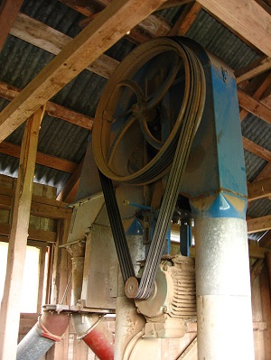
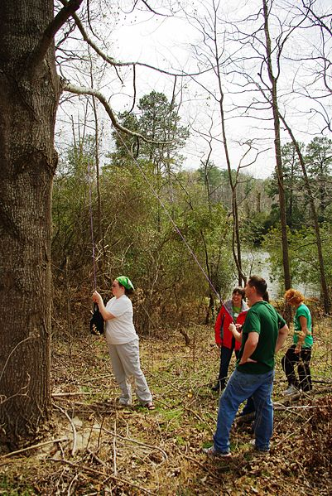
Belt Friction
Anywhere there is a belt or cable wrapped around a surface, there is the potential for belt friction.
Image by Kiilahihnakone CC-BY-SA 3.0
Image by Virginia State Park Staff CC-BY 2.0

Slide 3
Why Does Belt Friction Exist?
When we have tension in a belt, a normal force must exist to prevent the belt from falling.
If we have a normal force and the tensions differ, a friction force will exist that opposes the belt sliding over the surface it is wrapped around.
$$T_{1}=T_{2}$$
$$T_{1}$$
$$T_{2}$$
$$T_{1}<T_{2}$$
$$T_{1}$$
$$T_{2}$$

Slide 4
Types of Belts
Flat Belts
A system where the belt, rope, or cable is wrapped around a non-grooved or loosely grooved surface or pulley
Simplest system, offers a base level of potential friction.
V-Belts
A system where a belt is run through a V-shaped groove on pulley.
More complex, offers more potential friction.

Slide 5
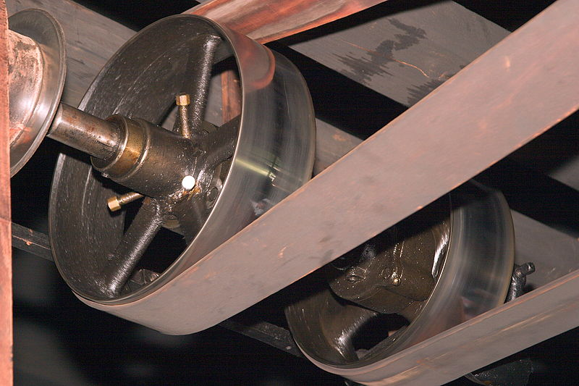
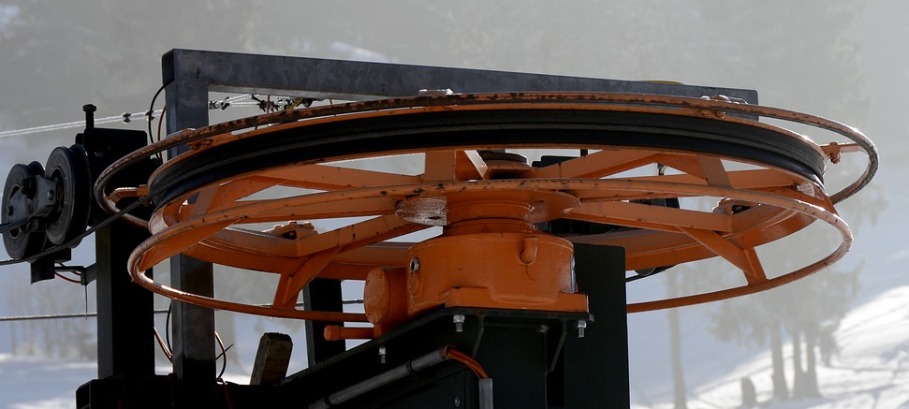
Friction in Flat Belts
A flat belt is any belt that only contacts the surface or pulley on its back surface.
Image by Ukexpat CC-BY-SA 3.0
Public Domain Image by annca

Slide 6


Flat Belts
Assuming impending motion (the belt is about to slip) and using some calculus since the normal force isn’t constant, we end up with the following equation for the difference in tension.
Coefficient of friction between belt material and surface
$$T_{1}$$
Euler’s constant
≈2.718
Angle of contact in radians
β
$$T_{2max}=T_{1}e^{μ_{s}β}$$
$$T_{2}$$
Always the smaller tension force
Always the larger tension force

Slide 7
Flat Belts
This represents a maximum for T₂ before slipping. Based on the actual value of T₂, the following will occur.
$$T_{2}<T_{2max}$$
Belt will not slip
$$T_{1}$$
$$T_{2}=T_{2max}$$
β
Belt about to slip
$$T_{2}$$
$$T_{2}>T_{2max}$$
Belt will slip

Slide 8
V belts
Some pulleys have a grove where the belt comes in contact with the side walls of the pulley rather than the bottom surface of the pulley. This effectively increases the normal forces on the belt, and therefore the friction between the belt and the pulley.
Flat Belt Pulley
V Belt Pulley

Slide 9
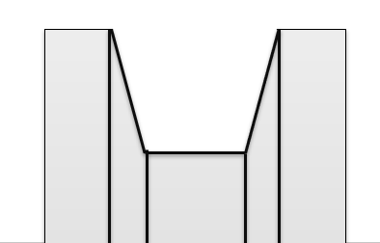

V belts
With the normal forces on the sides of the belt, they wind up being larger than they would be for a similar flat belt.
Larger normal forces means larger potential friction forces.
$$α$$

Slide 10
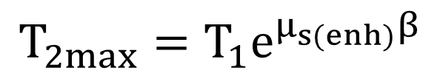
V belts
The increase in friction force depends upon the angle $α$
The new equation for the tension across a pulley is…
$$μ_{s\left(enh\right)}= \frac{μ_{s}}{sin⁡\left(\frac{α}{2}\right)}$$
$$T_{2max}=T_{1}e^{μ_{s(enh)}β}$$
where…
$$α$$

Slide 11
Maximum Torque and Power in Belt Driven Systems
In a belt driven system, we will sometimes need to know the torque or power that can be transmitted from input to output.
Once we know the maximum difference in tensions, we can easily calculate the torque and power transmitted by each pulley in the belt driven system
$$T_{1}=T_{resting}$$
Input
Output
M
M
$$T_{2}$$

Slide 12
Maximum Torque
The maximum input or output torque will simply be the net moment on the pulley when the tension difference is at a maximum.
Maximum input torque before slipping
$$M_{input max}=(T_{2max}−T_{1})(r_{input})$$
Maximum output torque before slipping
$$M_{output max}=(T_{2max}−T_{1})(r_{output})$$

Slide 13
Maximum Power
The rotational definition of power is the torque transmitted times the angular velocity in radians per second.
The power at the input and the output of the system should be the same, assuming no losses due to inefficiency.
$$P_{max}=\left(M_{input max}\right)\left(ω_{input}\right)=\left(M_{output max}\right)\left(ω_{output}\right)$$

Slide 14
Thanks for Watching
See other engineering mechanics videos and access the full tool at…

Slide 15
Flat Belt Worked Example
A steel cable supports a 60 kg mass and is then run a quarter of the way around a steel cylinder and supported by a pulling force as shown in the diagram below. The static coefficient of friction between the cable and the steel cylinder is .3.
What is the minimum pulling force required to lift the mass?
What is the minimum pulling force required to keep the mass from falling?
$$F_{pull}$$
60 kg

Slide 16
V belts Practice Problem
Find the maximum torque that this pulley (Diameter = 5 inches, ${(μ}_{s})=.4$) can exert before slipping if the resting tension in the belt is 20 lbs.
$$60°$$
210°
M

Slide 17
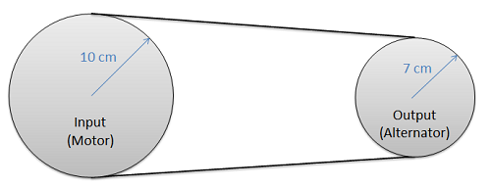
Power Worked Example
A flat belt is being used to transfer power from a motor to an alternator as shown in the diagram below. The coefficient of friction between the belt material and the pulley is .5. If we require a power of 100 Watts (Nm/s) while the input is rotating at a rate of 1000 rpm and the output is rotating at a rate of 1428.6 rpm, what is the required resting tension in the belt? (Assume contact angles of approximately 180 degrees)

